Slide 1
Git & GitHub
Omar Wael

Slide 2
What is git ?
is a free and open source distributed version control system designed to handle everything from small to very large projects with speed and efficiency.
It was created by Linus Torvalds in 2005

Slide 3
What is gitHub ?
allows software developers and engineers to create remote, public-facing repositories on the cloud for free. Once you’ve set up a repository on GitHub, you can copy it to your device, add and modify files locally, then “push” your changes back to the repository where your changes are displayed to the public.

Slide 4
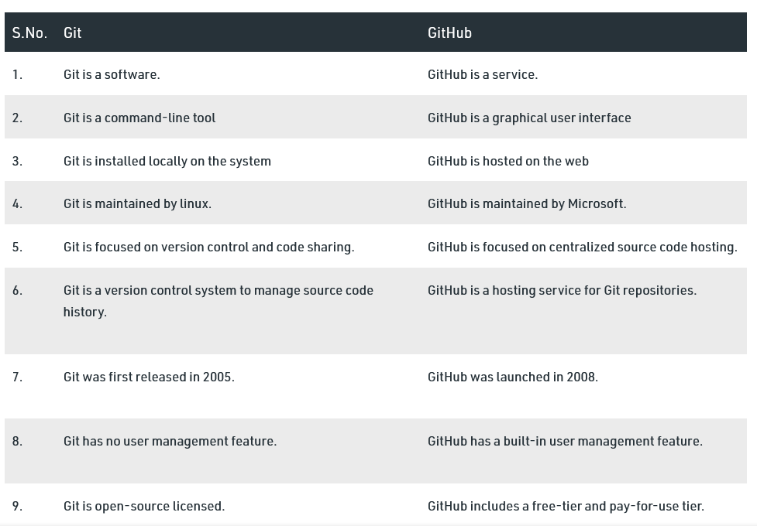
Git vs GitHub

Slide 5
Start your project with github
Signup on github (https://github.com)
Private plans (https://github.com/settings/billing/plans)
Create new Repository

Slide 6
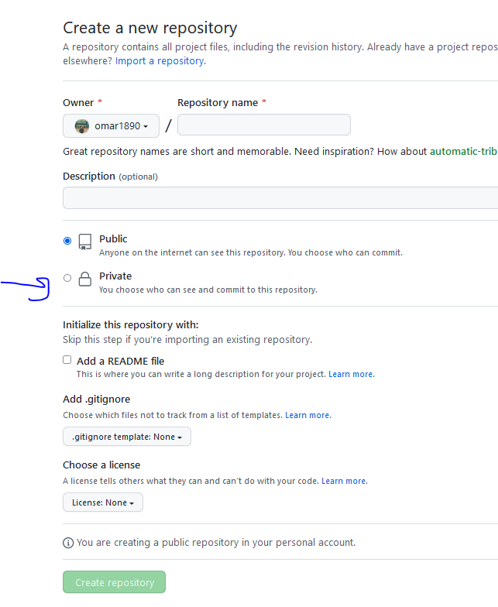
Create new Repository

Slide 7
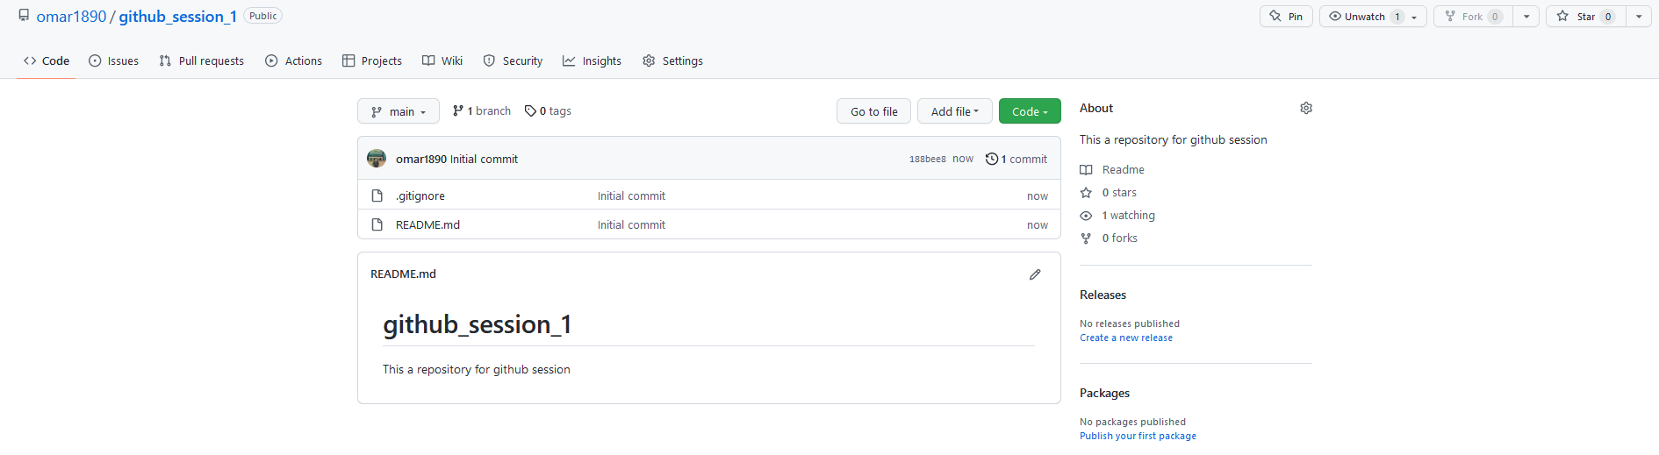
View your Repository

